Slide 1
Probabilistic Latent Variable Models for Knowledge Discovery and Optimization
Xiaolong Wang
Department of Computer Science
Apr-3-2016
Doctoral Committee:
Prof. Chengxiang Zhai, Chair
Prof. Jiawei Han
Prof. David Forsyth
Prof. Joy Ying Zhang, CMU & Facebook
Prof. Angelia Nedich, UIUC & ASU

Slide 2
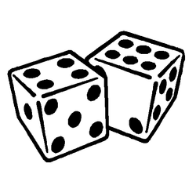
We must become more comfortable with probability and uncertainty
⎻ Nate Silver
Notes:
Nate Silver is a statistician who analyzes baseball and elections.
Forecast player performance based on measurements such as batting average for hitters or strikeout rate for pichers
Regression
Clustering players
Silver successfully called the outcomes in 49 of the 50 states in the 2008 U.S. Presidential election
In the 2012 United States presidential election, Silver correctly predicted the winner of all 50 states and the District of Columbia
Classification

Slide 3

An Era of Abundant Data
How To:
Represent the data and knowledge?
Model uncertainty and noise?
Scale well to large data?
Network
Text
Probabilistic Modeling
with Latent Variables
Images
Notes:
With increasing amount of the different types of data, how to we extract useful information?
In social network, who are spammers? How to find communities and how to characterize?
In news, how to find emerging topics? In literature, how to generate short summary for research evolution
Image recognition and segemantation

Slide 4
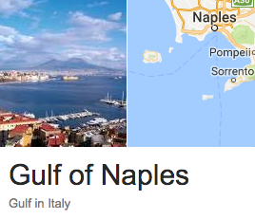
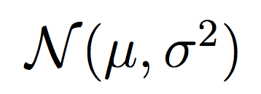
PLVM – An Historical Account
L
1893
W
R = W / L
Ratio of forehead width to the body length of 1000 crabs
Raphael Weldon
1860 - 1906
Karl Pearson
1857 - 1936
“A well-marked deviation from this normal shape”
A single normal fitting with
Maximum Likelihood Estimation (MLE)
“the units grouped together in the measured material are not really homogeneous??”
Notes:
Weldon collected 1000 crabs in Naples Bay in 1893 and
Measured the ratio of forehead width to the body length.
He plotted the histogram and fitted with a normal distribution.
However, he has his own doubts: there is a
“A well-marked deviation from this normal shape”
And he thinks
“the units grouped together in the measured material are
Not really homogeneous”
In other words, he hypothesized that the crabs are possibly
coming from two subspecies
With limited math knowledge, he turned to Pearson for help

Slide 5
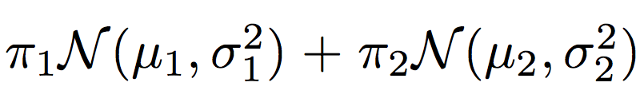
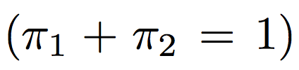
PLVM – An Historical Account
Karl Pearson
1857 - 1936
Two-normal fitting with Moment Matching (MOM)
Notes:
Pearson used two normal distributions to fit the data.
Nowadays we can use EM algorithm to compute the MLE.
At Pearson’s time computer was not invented yet so he chose to
Use moment matching (he also invented mom!).
Here we have 5 free variables, and thus we need to do moment
Matching up to the 5th moments.
Still this was a tedious computation task which amounts to a 9th
Degree poly
We plot the two curves of the component and their mixture is also
Shown which indeed seems a better fitting than walden’s result

Slide 6
PLVM – An Historical Account
Raphael Weldon
1860 - 1906
Karl Pearson
1857 - 1936

Slide 7
Why PLVM?
A flexible approach for modeling complex observations
A powerful tool for knowledge discovery
Efficient and scalable optimization for training

Slide 8
Contributions: 1/2
Citation LDA: Understanding Evolution of Research Themes
PLVM for analyzing network data
Thurstonian Pairwise Preference
PLVM for modeling expertise and truthfulness of workers in crowdsourcing and fusion of pairwise preferences

Slide 9
Contributions: 2/2
Dual Clustering Maximum Entropy
Maximum Entropy optimization algorithm leveraging PLVM
PLANS: Phrasal Latent Allocation with Negative Sampling
PLVM for phrasal embedding

Slide 10
Citation LDA: Understanding Evolution of Research Themes
Dual Clustering Maximum Entropy
PLANS: Phrasal Latent Allocation with Negative Sampling
Thurstonian Pairwise Preference

Slide 11
The Evolution Graph
Discovering the Research Topics
Topic Milestone Papers
Topic Temporal Strength
Topic Keywords
Discovering the Theme Evolution
Topic Importance
Topic Dependency
Evolution Patterns
Citation-LDA:
A General Modeling Approach for Network Data
Notes:
Given a corpus literature citations, we are intersted in

Slide 12
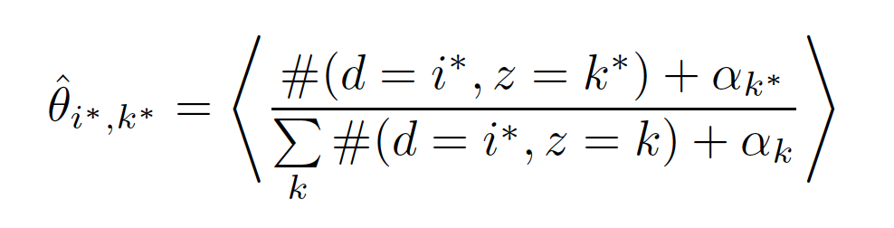
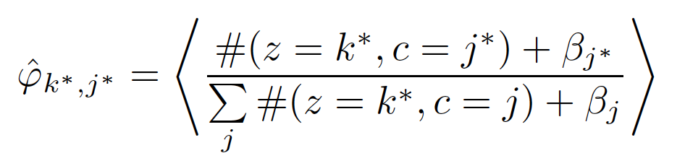
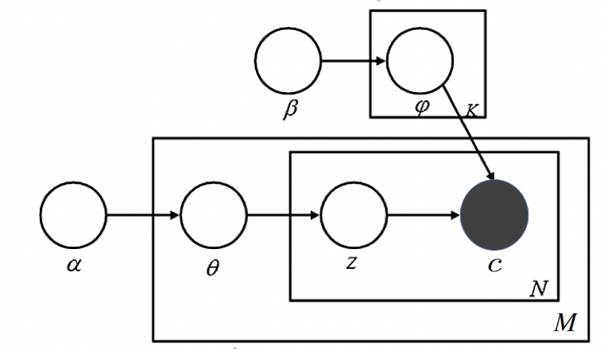
Citation-LDA
Posterior Expectation:
 | LDA | Citation-LDA
Topic | Distribution over Words | Distribution over Cited Papers
Document | Bag of Words | Bag of Cited Papers
Multinomial over Cited Papers Given a Topic
Citation-Network:
A paper can be both a citing paper and an cited paper
General-Network:
A node can be connected both by an outgoing edge or an incoming edge
Multinomial over Latent Topics Given a Citing Paper
Notes:
The generative model is no different from the LDA model.
However, each topic is a distribution over cited papers
and each document is represented as a bag of cited papers.

Slide 13
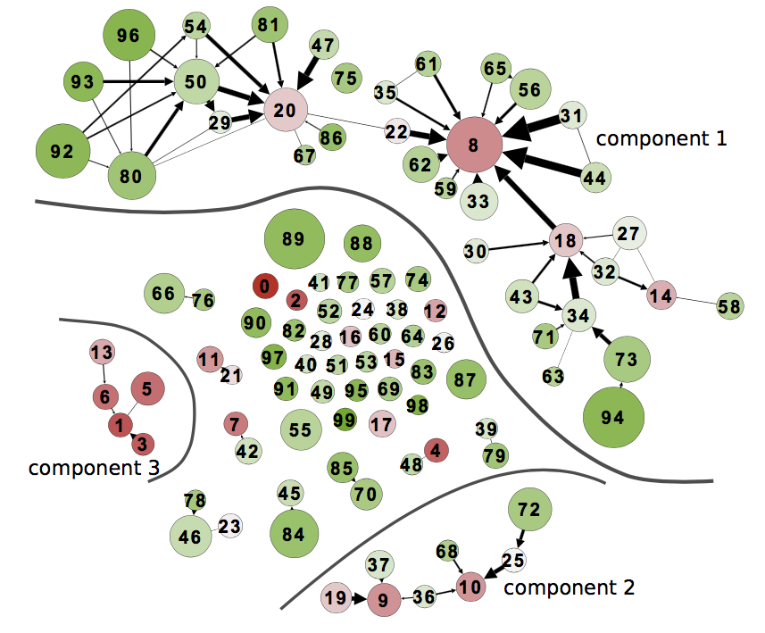

Discovering the Theme Evolution
Word Sense Disambiguation, 91’
1983’
2013’
Statistical Machine Translation
Prepositional Phrase Attachment, 94’
Statistical Parsing, 99’
Grammars
(faded in 90s)
Discriminative Parsing, 03’
Dependency Parsing, 05’
Discourse/Dialogue
Summarization
AAN
Notes:
Thickness of edge represents the dependency from one topic to another topic.
We only plot a edge if the dependency is significant. And it can be used to show
Research theme evolution

Slide 14
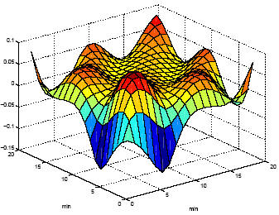

Citation-LDA: Summary a General PLVM for Network Data
Flexible Modelling
Modeling Citations as a Mixture of Latent Topics
Discovering Research Topics:
milestone papers, temporal strength, keywords
Discovery the Theme Evolution:
topic importance and dependency, theme evolution patterns
Powerful Tool for KDD

Slide 15
Citation LDA: Understanding Evolution of Research Themes
Dual Clustering Maximum Entropy
PLANS: Phrasal Latent Allocation with Negative Sampling
Thurstonian Pairwise Preference

Slide 16
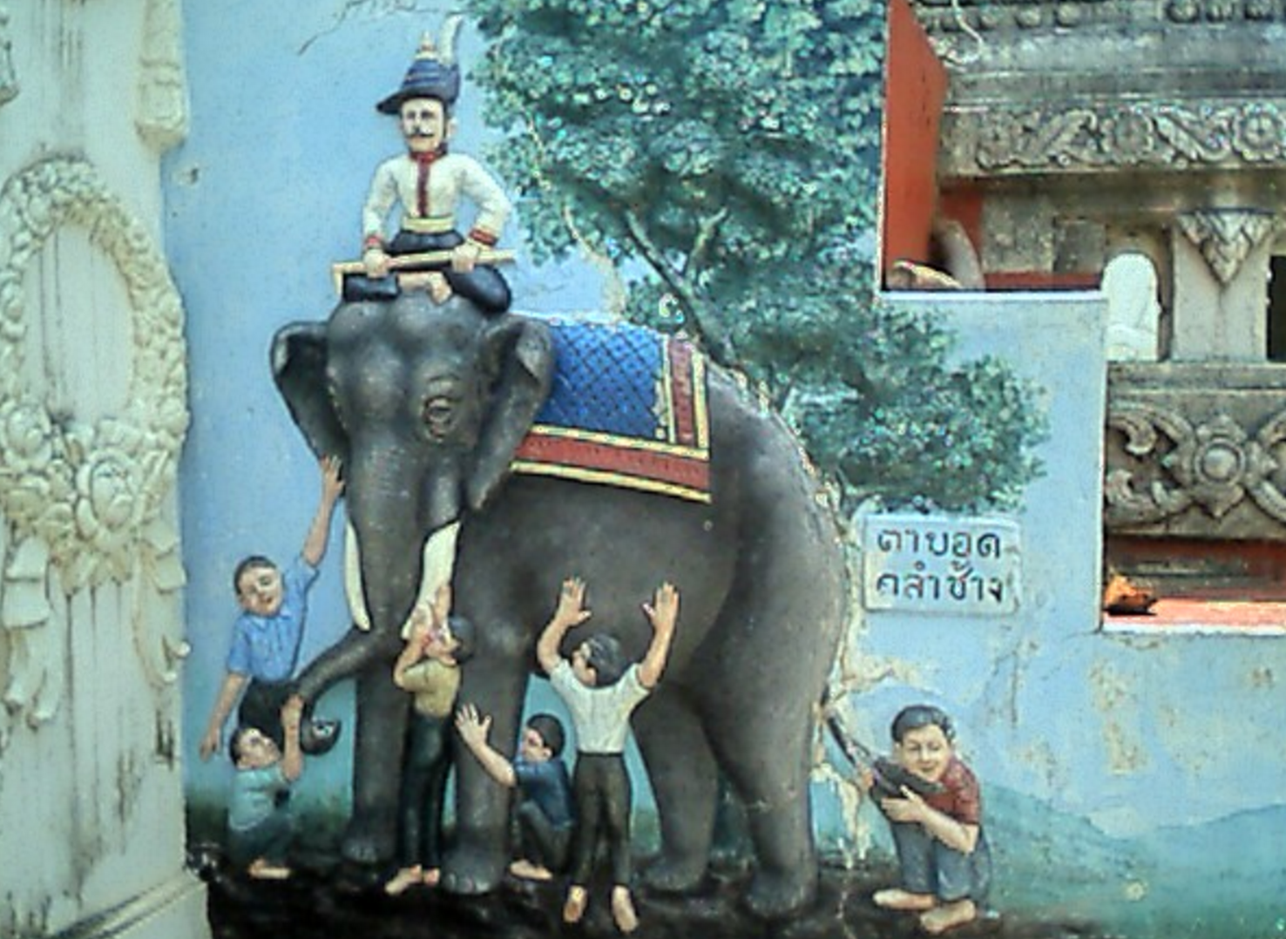

Blind Men and The Elephant: Convert Ranking to Pairwise Preferences
a Complicated Problem
a Series of Smaller and Easier Tasks
Challenges:
Incompleteness and Inconsistency
Notes:
Suppose we have a complicated problem, it is natural to break down the problem into
a series of smaller and easier tasks.
Just like blind men and the elephant, though the ability of each blind men is limited,
They can each touch a part of the elephant such as tusks or the leg.
However, if there is no an intelligent thinking machine to synthesis the
observations, they would disagree, and argue and there is no conclusion achieved.
The major challenges is to resolve incompleteness and inconsistency.
We investigate this idea in the crowdsourcing setting. Insetad of annotating
Ranked list by experts, we ask crowd workers to label only pairwise preferences.
Our challenges is because of the non-expert nature of the workers, we need to estimate
Query difficulty, domain, worker expertise and truthfulness.

Slide 17






Blind Men and The Elephant: Convert Ranking to Pairwise Preferences
Ranking
annotated by
Experts
Pairwise Preferences
annotated by
Crowd Workers
TPP
Thustonian Pairwise Preference (TPP)
Query Difficulty and Domain
Worker Expertise and Truthfulness
16

Slide 18
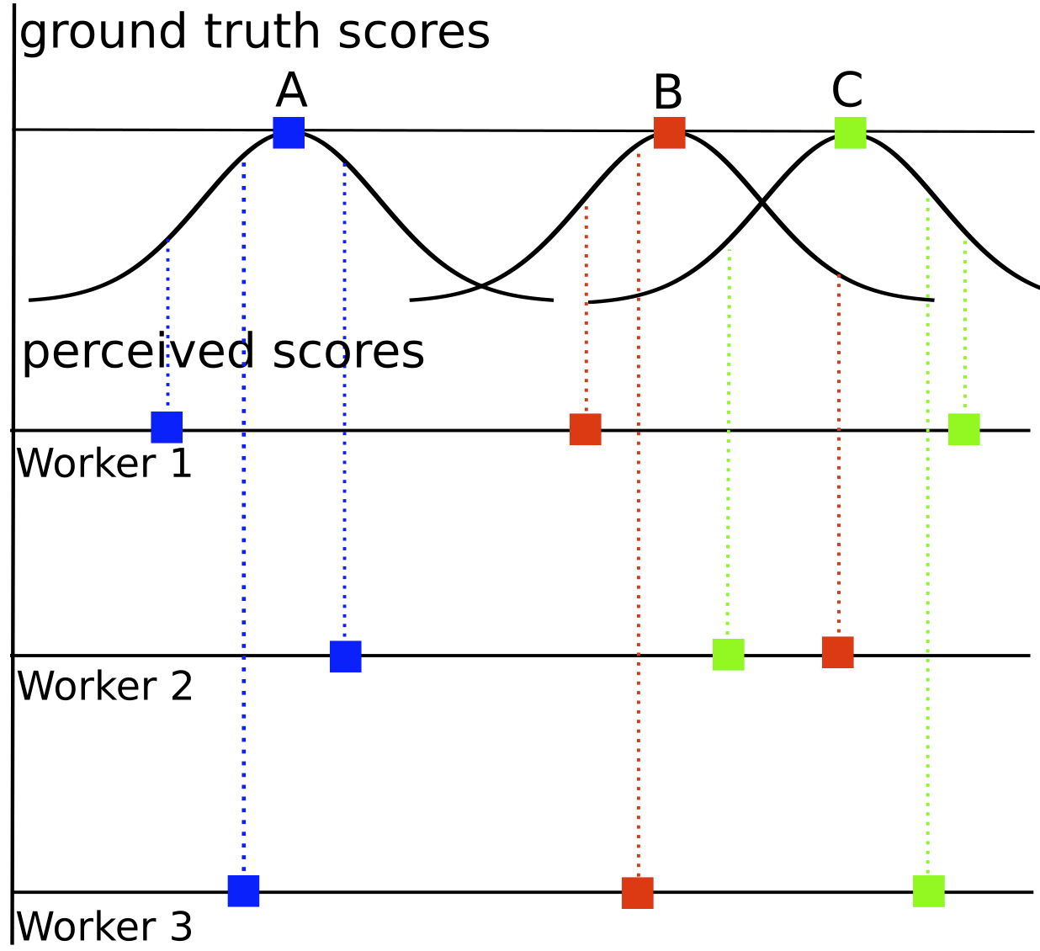
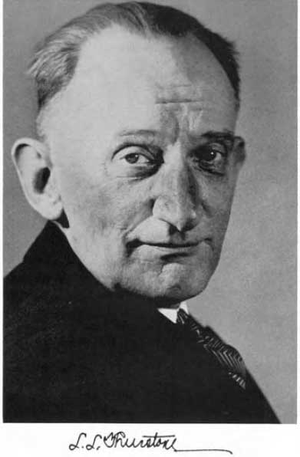



Thurstonian Ranking Model (TRM): PLVM for Ranked Lists
Scalable Gibbs sampling
By Ulf Böckenholt (92’-93’), (was) a UIUC Professor
A > B > C
Ulf Böckenholt
Louis Leon Thurstone
1887 - 1955
A > C > B
A > B > C
Which one is the true ranking?
TRM:
Modeling ranked lists as judgement of scores following normal distributions
Notes:
Let us first take a moment to consider a simpler problem where our observation is the ranked
lists annotated by workers, and the goal is to estimate the ground truth ranked lists. Thurstonian
Proposed the TRM.
He assumed that the judgements of the ranked lists is a result of the real-value perceived scores
From each worker and the worker’s perceived score is distributed as normal with means called
Ground truth scores.
The first practical algorithm for optimization was proposed by bockenholt. He was a uiuc professor
When the work was done. Estimation was done using gibbs sampling

Slide 19
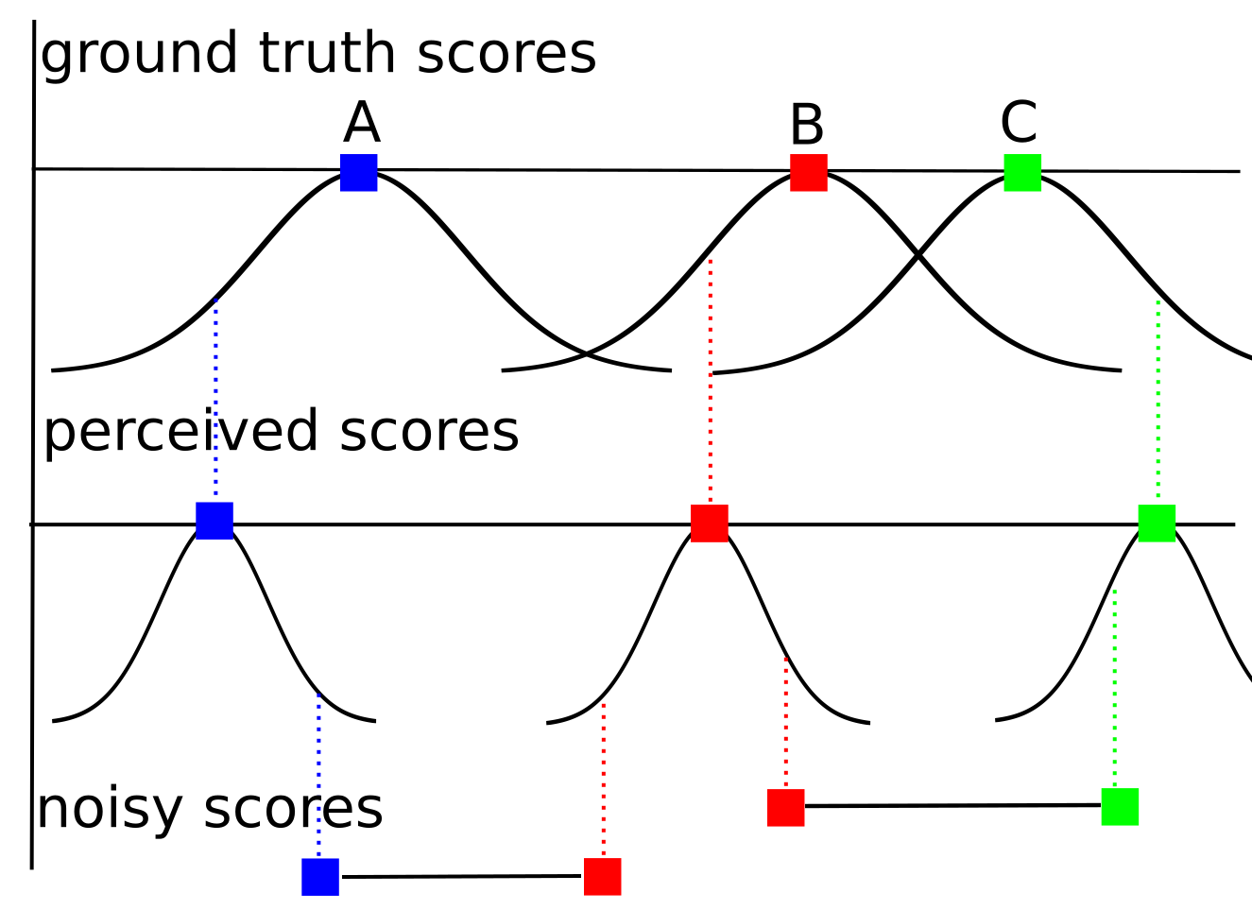
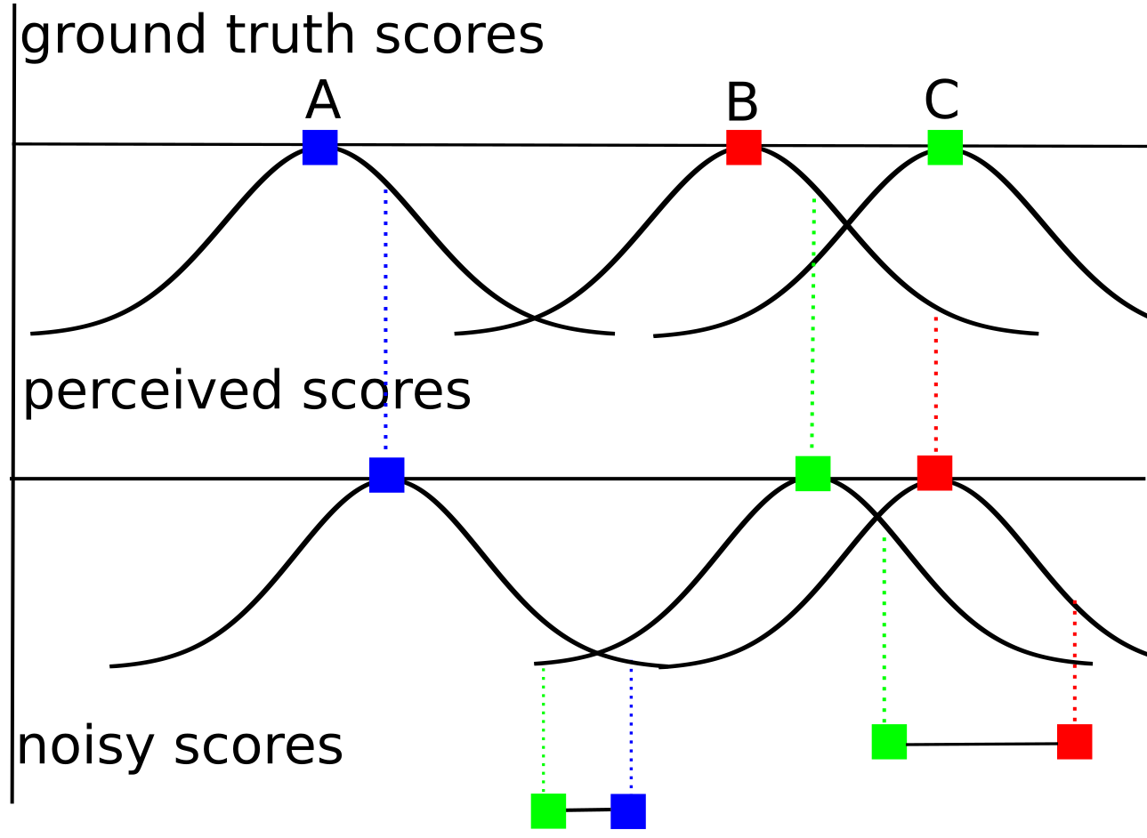
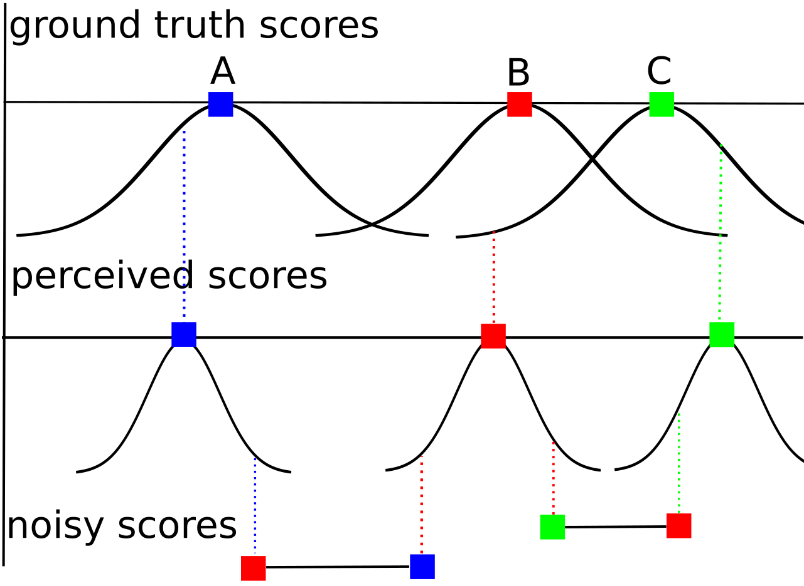

Thurstonian Pairwise Preference (TPP): PLVM for Pairwise judgements
Worker
Expertise
Modeling Pairwise Preferences:
Query
Difficult
No Error
Error due to Low Expertise
Error due to “Flipping”
Expert (on the query domain)
Truthful
Limited expertise
Truthful
Expert
Malicious
Error due to Difficult Query
Notes:
After generating the perceived score, in our setting we need to further generate the pairwise preferences.
We assume in addition to TRM, there is another step of generation, which draws noisy score from normal
distributions with mean being the perceived scores. The variance of this normal distribution is determined by
The domain expertise of the workers as well as their truthfulness.
Here are some examples.

Slide 20
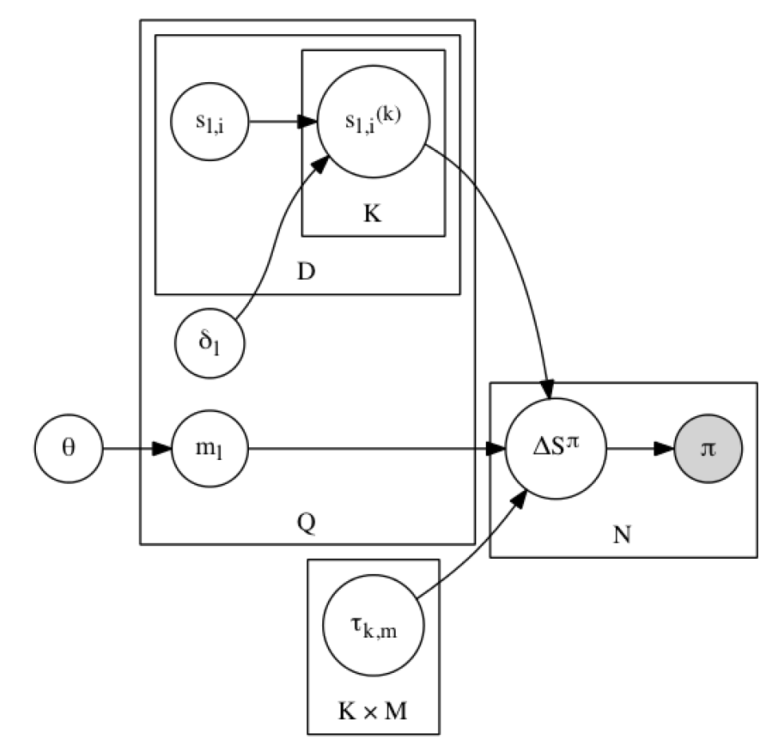
Thurstonian Pairwise Preference
ground truth score (mean)
perceived score
(mean)
Worker
Doc
noisy score difference
query domain
mixture prior
difficulty (std)
domain
Query
Judgement
expertise and
truthfulness (std)
Observation:
pairwise preference
Worker ☓ Domain

Slide 21
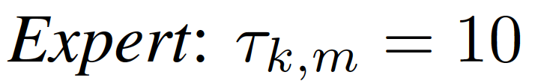
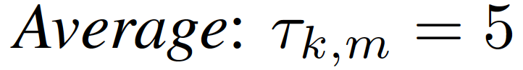
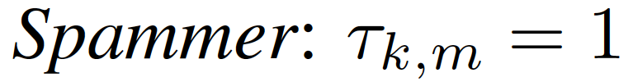
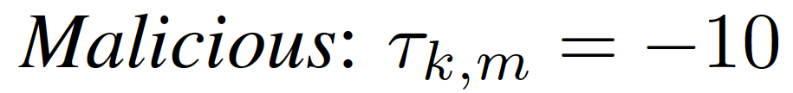
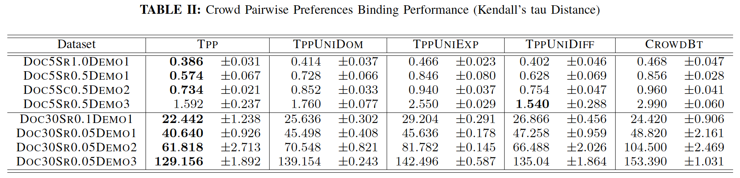
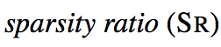
TPP: Simulated Study
0.2
0.6
0.1
0.1
Demo 1
0.2
0.4
0.3
0.1
Demo 2
0.2
0.4
0.1
0.3
Demo 3
5 docs
30 docs
full model
same worker expertise
(Chen et al., 2013)
only 1 domain
same query difficulty

Slide 22
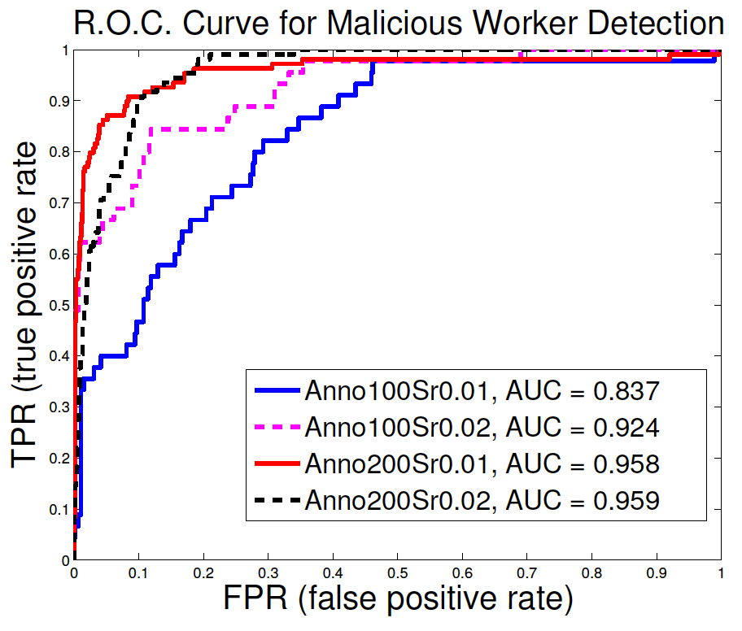
TPP: Malicious Worker Detection
100/200 annotators
10 malicious workers in 100 group
20 malicious workers in 200 group
Sparsity ratio
0.01 (4.35 out of 435 pairs)
0.02 (8.7 out of 435 pairs)

Slide 23
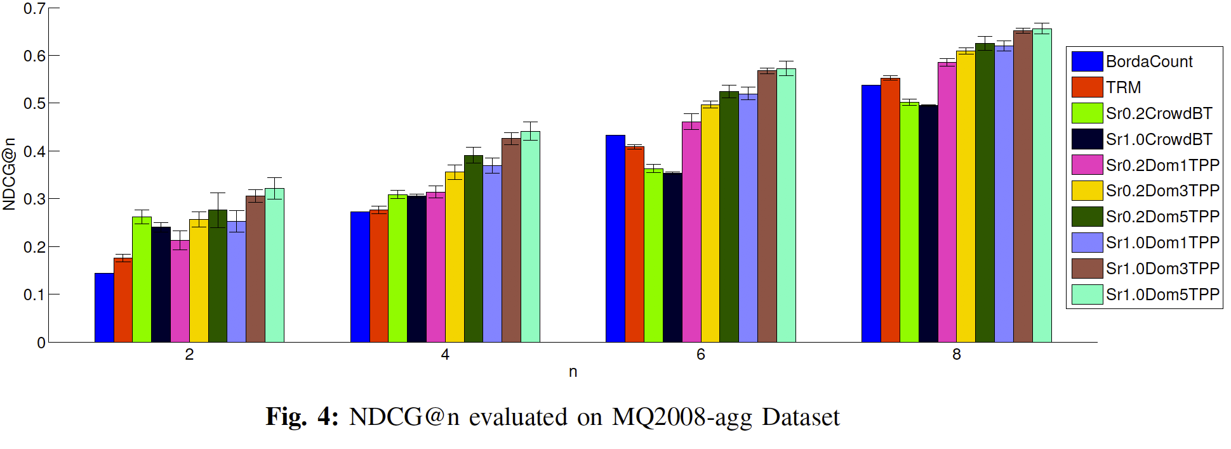
TPP: Rank Aggregation
25 retrieval systems
25 workers for TPP
Rank Aggregation Baselines:
TRM
BordaCount
Majority Voting for Ranking

Slide 24

TPP: Summary a general PLVM for modeling expertise and truthfulness of workers in crowdsourcing and fusion of pairwise preferences
Flexible Modelling
Modeling Pairwise Preferences in Crowdsourcing by
extending Thurstonian Ranking Model
explaining errors/uncertainty with a multitude of sources
query difficulty, query domain
worker domain expertise, truthfulness
Powerful Tool for KDD
Efficient Optimization
EM algorithm: E-step by Sampling

Slide 25
Citation LDA: Understanding Evolution of Research Themes
Dual Clustering Maximum Entropy
PLANS: Phrasal Latent Allocation with Negative Sampling
Thurstonian Pairwise Preference

Slide 26
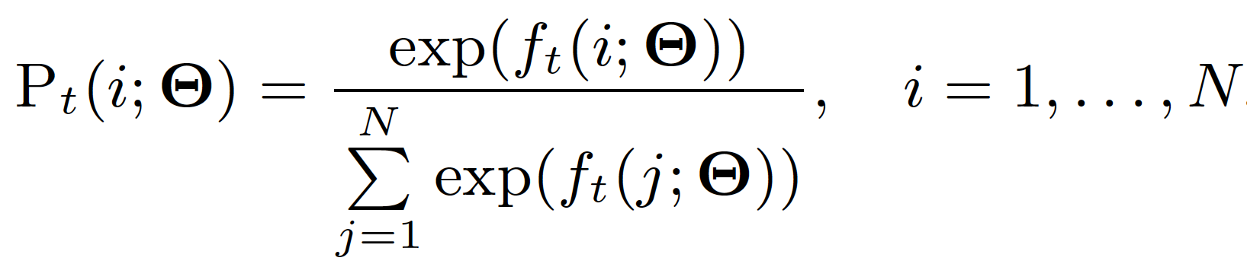
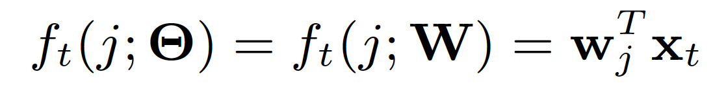
Maximum Entropy: A Versatile Tool
Maximum Entropy (ME) Framework:
Classification: with known feature vector
hypothesis for
positive class
t-th feature
vector
x_{t}
hypothesis for
negative class
w₁
w₂
f_{t}(neg)
f_{t}(pos)

Slide 27
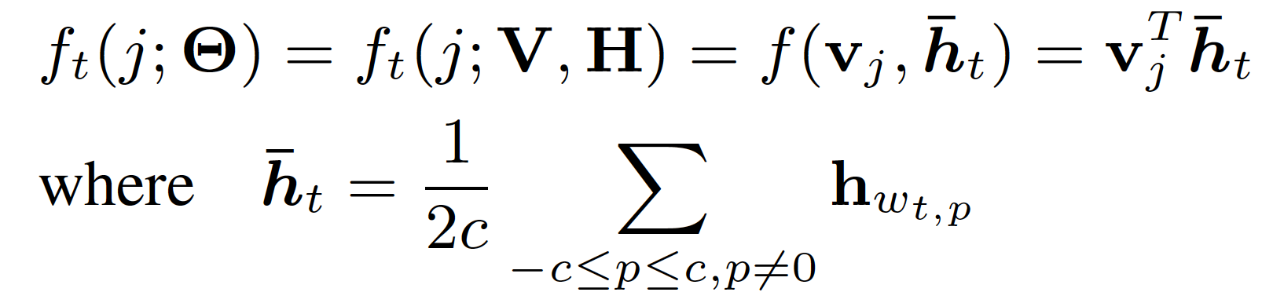
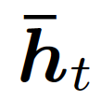
Maximum Entropy: A Versatile Tool
Maximum Entropy (ME) Framework:
Embedding: with unknown feature vector (representation)
recursive ?? network
?? = neural vs ?? = social
f_{t}(neural)
Continuous Bag-of-Words (CBOW)
(Milokov et al. 2013)
v_{neural}
h_{network}
h_{recursive}
v_{social}
f_{t}(social)

Slide 28
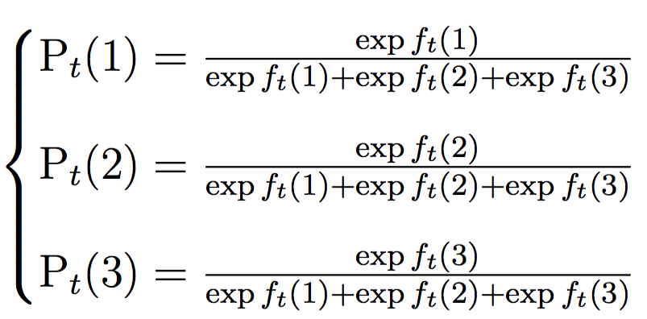
Maximum Entropy: Difficulty in Scaling
Classes: > 10⁴ MeSH (Medical Subject Heading) tags
Vocabulary: >1M words
How Does Gradient Descent (GD) of ME works?
GD Complexity:
O(DN)
D – feature dimensionality
N – number of classes
w₁
x_{t}
w₂
f_{t}(1)
w₃
3-class classification

Slide 29
Maximum Entropy: Difficulty in Scaling
Classes: > 10⁴ MeSH (Medical Subject Heading) tags
Vocabulary: >1M words
How Does Gradient Descent (GD) of ME works?
GD Complexity:
O(DN)
D – feature dimensionality
N – number of classes
w₁
x_{t}
w₂
f_{t}(2)
w₃
3-class classification

Slide 30
Maximum Entropy: Difficulty in Scaling
Classes: > 10⁴ MeSH (Medical Subject Heading) tags
Vocabulary: >1M words
How Does Gradient Descent (GD) of ME works?
GD Complexity:
O(DN)
D – feature dimensionality
N – number of classes
w₁
x_{t}
w₂
f_{t}(3)
w₃
3-class classification

Slide 31
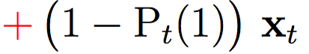
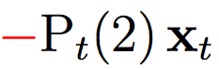
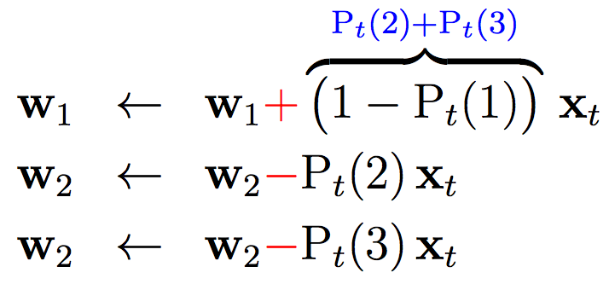
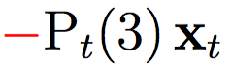
Maximum Entropy: Difficulty in Scaling
Classes: > 10⁴ MeSH (Medical Subject Heading) tags
Vocabulary: >1M words
How Does Gradient Descent (GD) of ME works?
GD Complexity:
O(DN)
D – feature dimensionality
N – number of classes
w₁
Suppose the correct label y_{t} = 1,
and gradient descent updates:
x_{t}
w₂
w₃
3-class classification

Slide 32
Maximum Entropy: Difficulty in Scaling
Classes: > 10⁴ MeSH (Medical Subject Heading) tags
Vocabulary: >1M words
How Does Gradient Descent (GD) of ME works?
GD Complexity:
O(DN)
D – feature dimensionality
N – number of classes
w₁
Suppose the correct label y_{t} = 1,
and gradient descent updates:
x_{t}
w₂
w₃
3-class classification

Slide 33
Maximum Entropy: Difficulty in Scaling
Classes: > 10⁴ MeSH (Medical Subject Heading) tags
Vocabulary: >1M words
How Does Gradient Descent (GD) of ME works?
GD Complexity:
O(DN)
D – feature dimensionality
N – number of classes
w₁
Suppose the correct label y_{t} = 1,
and gradient descent updates:
x_{t}
w₂
w₃
3-class classification

Slide 34
Maximum Entropy: Difficulty in Scaling
Classes: > 10⁴ MeSH (Medical Subject Heading) tags
Vocabulary: >1M words
How Does Gradient Descent (GD) of ME works?
GD Complexity:
O(DN)
D – feature dimensionality
N – number of classes
w₁
Suppose the correct label y_{t} = 1,
and gradient descent updates:
x_{t}
w₂
3-class classification
w₃

Slide 35
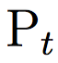
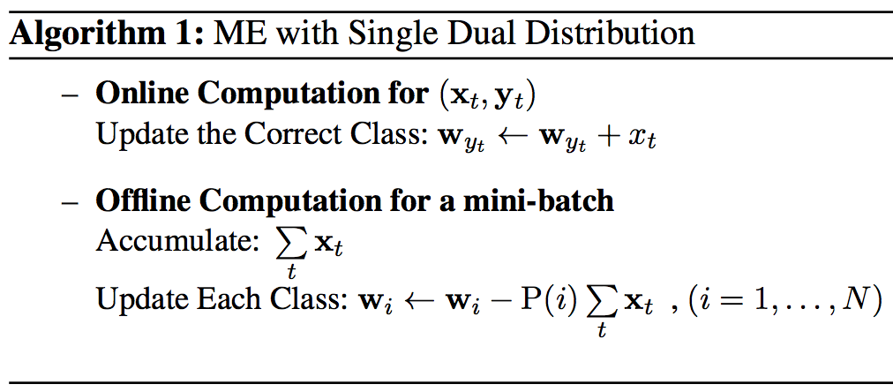
Dual-Clustering Maximum Entropy (DCME)
w₁
w₁
x_{t}
w₁
Goal:
Complexity Independent of
N (#class)
Solution: Approximating/Clustering Dual Distributions {P_{t}}
x_{t}
w₂
w₂
w₂
x_{t}
w₃
w₃
w₃
t = 1, y_{t} =1
t = 2, y_{t} =2
t = 3, y_{t} = 3
x₁
x₂
w₁
w₂
x₃
w₃

Slide 36
Dual-Clustering Maximum Entropy (DCME)
w₁
w₁
x_{t}
w₁
Goal:
Complexity Independent of
N (#class)
Solution: Approximating/Clustering Dual Distributions {P_{t}}
x_{t}
w₂
w₂
w₂
x_{t}
w₃
w₃
w₃
t = 1, y_{t} =1
t = 2, y_{t} =2
t = 3, y_{t} = 3
x₁
w₁
x₂
w₂
w₃
x₃

Slide 37
Dual-Clustering Maximum Entropy (DCME)
w₁
w₁
x_{t}
w₁
Goal:
Complexity Independent of
N (#class)
Solution: Approximating/Clustering Dual Distributions {P_{t}}
x_{t}
w₂
w₂
w₂
x_{t}
w₃
w₃
w₃
t = 1, y_{t} =1
t = 2, y_{t} =2
t = 3, y_{t} = 3
x₃
x₂
x₁

Slide 38

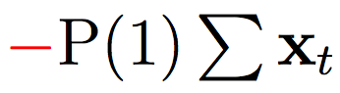
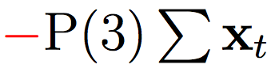
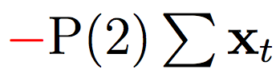
Dual-Clustering Maximum Entropy (DCME)
w₁
w₁
x_{t}
w₁
Goal:
Complexity Independent of
N (#class)
Solution: Approximating/Clustering Dual Distributions {P_{t}}
x_{t}
w₂
w₂
w₂
x_{t}
w₃
w₃
w₃
t = 1, y_{t} =1
t = 2, y_{t} =2
t = 3, y_{t} = 3
x₃
x₂
x₁ + x₂ + x₃
x₁
w₁
w₂
w₃

Slide 39
Dual-Clustering Maximum Entropy (DCME)
w₁
w₁
x_{t}
w₁
DCME Complexity:
O(DK)
D – feature dimensionality
K – number of clusters
if mini-batch size = O(N)
x_{t}
w₂
w₂
w₂
x_{t}
w₃
w₃
w₃
t = 1, y_{t} =1
t = 2, y_{t} =2
t = 3, y_{t} = 3
x₃
x₂
x₁ + x₂ + x₃
x₁
w₁
w₂
w₃

Slide 40
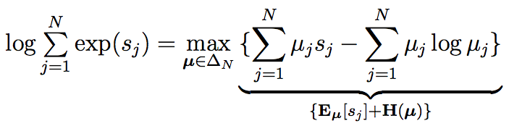
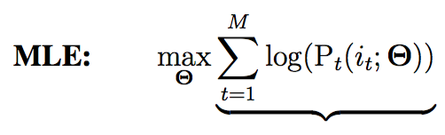
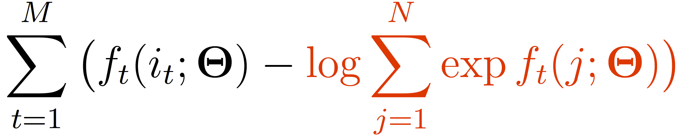
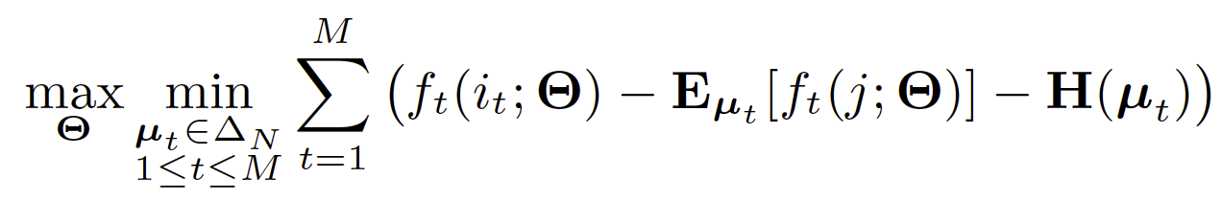
DCME: Primal-Dual ME
Conjugate between Log Partition and Negative Entropy:
Maximum Entropy
Primal-Dual ME

Slide 41
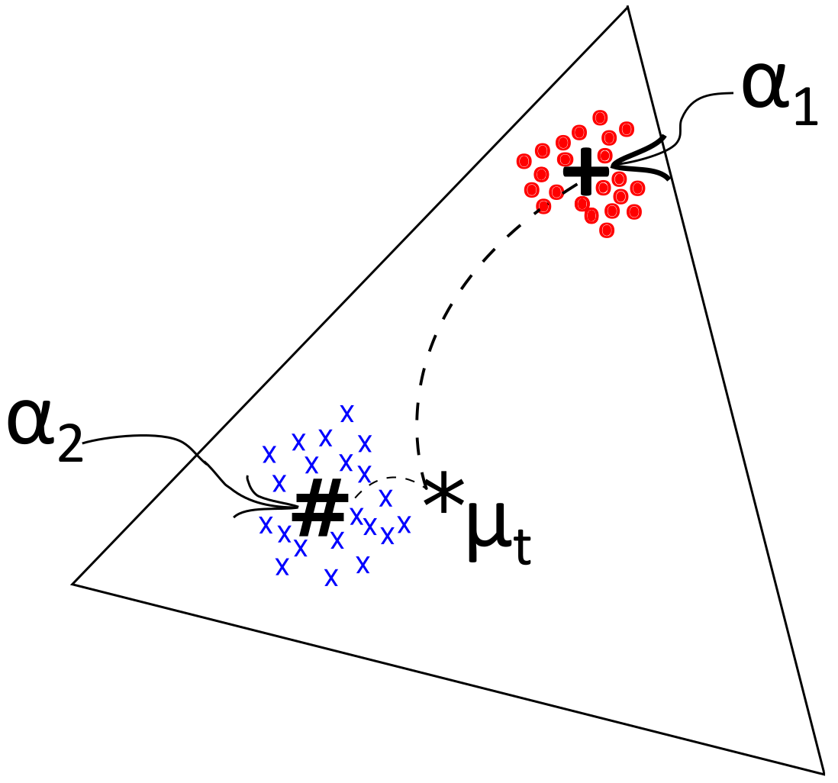
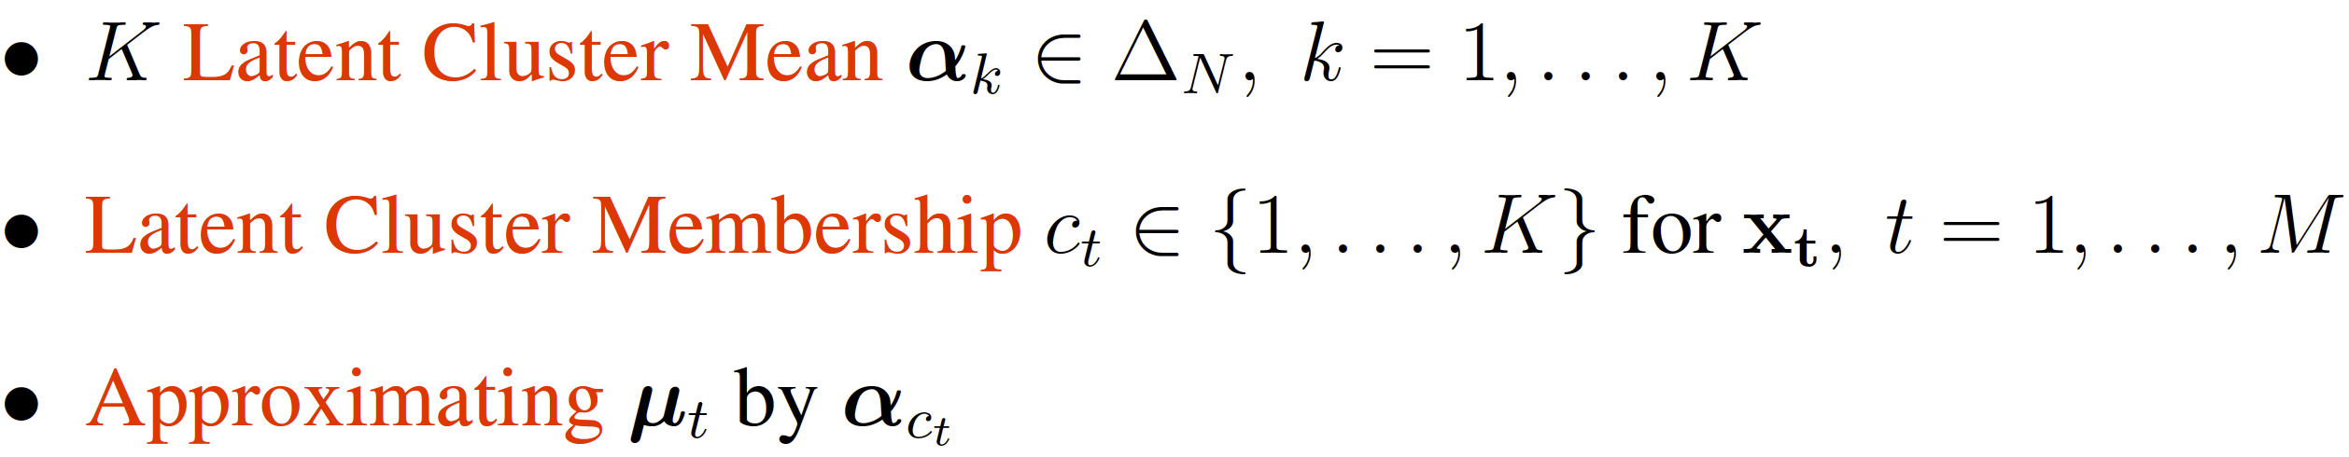
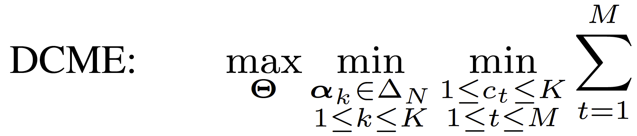
DCME: Primal-Dual ME
Primal-Dual ME
Dual-Clustering ME

Slide 42
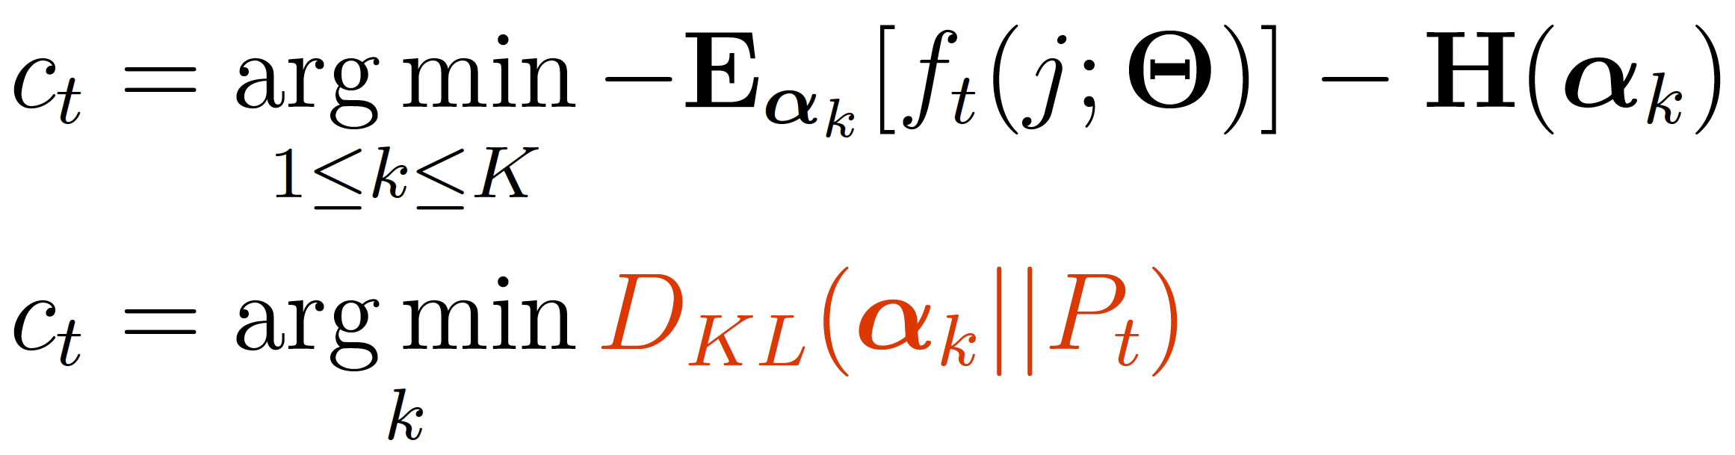
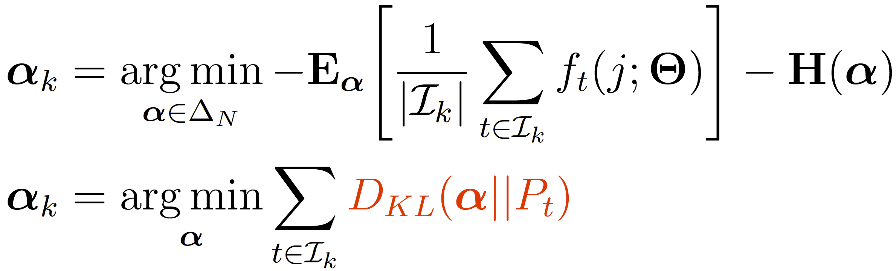
DCME: Dual-Clustering
Using Conjugate
Again!
Updating cluster assignments (Online):
Updating cluster centers (Offline)

Slide 43
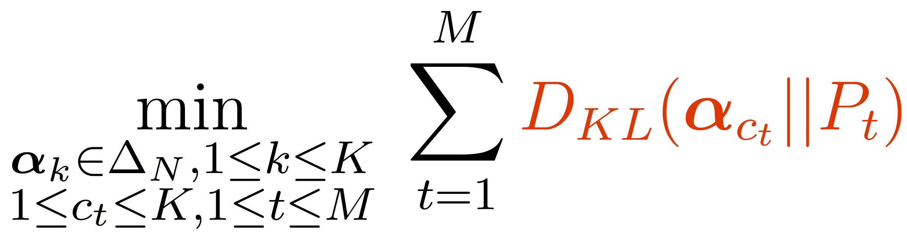
DCME: Dual-Clustering
Dual-Clustering:
K-means with Two Ingredients:
Clustering in the Simplex Space
Instead of Euclidean space
Measuring “Distance” in KL Divergence
Instead of L₂ distance

Slide 44
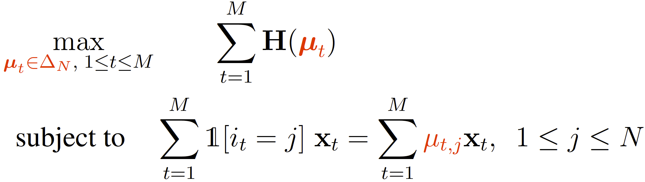

DCME: Dual Form as Feature Pursuit
ME:
DCME:

Slide 45

DCME: Experiment on Classification and Embedding
Baselines:
Gradient Descent
Noise-Contrastive Estimation
Negative Sampling
(Mikolov et al. 2013 )

Slide 46
DCME: Summary a general Maximum Entropy optimization algorithm leveraging PLVM
Flexible Modelling
Modeling Dual Distributions in Maximum Entropy:
K-means latent clustering
Approximating each distribution by the corresponding cluster center
Scalable Optimization:
A hybrid online-offline algorithm
Complexity depends only on #cluster, but not #class
Effective model update: no sampling involved
Efficient Optimization

Slide 47
Citation LDA: Understanding Evolution of Research Themes
Dual Clustering Maximum Entropy
PLANS: Phrasal Latent Allocation with Negative Sampling
Thurstonian Pairwise Preference

Slide 48

Embedding: Beyond Word Representation
Word Embedding: A Skipgram Scheme
W_{t-2}
W_{t-1}
W_{t}
W_{t+1}
W_{t+2}
Maximize: log P(w_{t}|w_{t-2})

Slide 49

Embedding: Beyond Word Representation
Word Embedding: A Skipgram Scheme
W_{t-2}
W_{t-1}
W_{t}
W_{t+1}
W_{t+2}
Maximize: log P(w_{t}|w_{t-2}) + log P(w_{t}|w_{t-1})

Slide 50

Embedding: Beyond Word Representation
Word Embedding: A Skipgram Scheme
W_{t-2}
W_{t-1}
W_{t}
W_{t+1}
W_{t+2}
Maximize: log P(w_{t}|w_{t-2}) + log P(w_{t}|w_{t-1}) + log P(w_{t}|w_{t+1})

Slide 51

Embedding: Beyond Word Representation
Word Embedding: A Skipgram Scheme
W_{t-2}
W_{t-1}
W_{t}
W_{t+1}
W_{t+2}
Maximize: log P(w_{t}|w_{t-2}) + log P(w_{t}|w_{t-1}) + log P(w_{t}|w_{t+1}) + log P(w_{t}|w_{t+2})
Limitations of Bag-of-Words Assumption:
Words are contextually unaware
bank
“I made a deposit in the bank.”
“We walked on the river bank.”

Slide 52
Embedding: Beyond Word Representation
Word Embedding: A Skipgram Scheme
W_{t-2}
W_{t-1}
W_{t}
W_{t+1}
W_{t+2}
Maximize: log P(w_{t}|w_{t-2}) + log P(w_{t}|w_{t-1}) + log P(w_{t}|w_{t+1}) + log P(w_{t}|w_{t+2})
Limitations of Bag-of-Words Assumption:
Words are contextually unaware
Sentence is simple average of words
presidential residence
the White House
the house in white
Machine
Human

Slide 53
PLANS: Phrasal Latent Allocation with Negative Sampling
Jointly Learning of:
Phrasal Allocation
computer
scientists
working
in
artificial
intelligence
and
machine
learning
artificial

Slide 54
PLANS: Phrasal Latent Allocation with Negative Sampling
Jointly Learning of:
Phrasal Allocation
computer
scientists
working
in
artificial
intelligence
and
machine
learning
in artificial

Slide 55
PLANS: Phrasal Latent Allocation with Negative Sampling
Jointly Learning of:
Phrasal Allocation
computer
scientists
working
in
artificial
intelligence
and
machine
learning
working in artificial

Slide 56
PLANS: Phrasal Latent Allocation with Negative Sampling
Jointly Learning of:
Phrasal Allocation
computer
scientists
working
in
artificial
intelligence
and
machine
learning
in artificial intelligence

Slide 57
PLANS: Phrasal Latent Allocation with Negative Sampling
Jointly Learning of:
Phrasal Allocation
computer
scientists
working
in
artificial
intelligence
and
machine
learning
artificial intelligence and

Slide 58
PLANS: Phrasal Latent Allocation with Negative Sampling
Jointly Learning of:
Phrasal Allocation
computer
scientists
working
in
artificial
intelligence
and
machine
learning
artificial intelligence

Slide 59




PLANS: Phrasal Latent Allocation with Negative Sampling
Jointly Learning of:
Phrasal Allocation
Embedding Estimation
computer
scientists
working
in
artificial
intelligence
and
machine
learning
artificial intelligence
artificial intelligence
algorithm
machine learning
artificial food additives
Embedding space

Slide 60
PLANS
3 Ingredients:
Transient Chinese Restaurant Process (tCRP)
Negative Sampling for Embedding Learning (NS)
Simulated Annealing (SA)
An Multithread Implementation:
Lock-free Hogwild for Phrase Posterior Sampling and Embedding Learning
Minimal-lock for Adding Tables and Periodical Shrinking in tCRP

Slide 61


PLANS: Ingredient 1 Transient Chinese Restaurant Process
Chinese Restaurant Process
Dirichlet Process (DP) generalizes multinomial distribution
Infinite dimension
CRP is an implementation of sampling from DP
Gibbs sampling with replacement
3
2
3

Slide 62

PLANS: Ingredient 1 Transient Chinese Restaurant Process
Chinese Restaurant Process
Dirichlet Process (DP) generalizes multinomial distribution
Infinite dimension
CRP is an implementation of sampling from DP
Gibbs sampling with replacement
…
2
2
3
$$α$$

Slide 63
PLANS: Ingredient 1 Transient Chinese Restaurant Process
Chinese Restaurant Process
Dirichlet Process (DP) generalizes multinomial distribution
Infinite dimension
CRP is an implementation of sampling from DP
Gibbs sampling with replacement
…
2
3
3
$$α$$

Slide 64
PLANS: Ingredient 1 Transient Chinese Restaurant Process
Chinese Restaurant Process
Dirichlet Process (DP) generalizes multinomial distribution
Infinite dimension
CRP is an implementation of sampling from DP
Gibbs sampling with replacement
…
1
3
3
$$α$$

Slide 65
PLANS: Ingredient 1 Transient Chinese Restaurant Process
Chinese Restaurant Process
Dirichlet Process (DP) generalizes multinomial distribution
Infinite dimension
CRP is an implementation of sampling from DP
Gibbs sampling with replacement
…
1
3
3
1
$$α$$

Slide 66
PLANS: Ingredient 1 Transient Chinese Restaurant Process
Chinese Restaurant Process
Dirichlet Process (DP) generalizes multinomial distribution
Infinite dimension
CRP is an implementation of sampling from DP
Gibbs sampling with replacement
…
1
3
2
1
$$α$$

Slide 67
PLANS: Ingredient 1 Transient Chinese Restaurant Process
Chinese Restaurant Process
Dirichlet Process (DP) generalizes multinomial distribution
Infinite dimension
CRP is an implementation of sampling from DP
Gibbs sampling with replacement
…
2
3
2
1
$$α$$
Limitations of CRP:
Sample with replacement
Cannot work with customers in a stream
Each customer chooses one from all tables
Huge computational complexity

Slide 68

PLANS: Ingredient 1 Transient Chinese Restaurant Process
Customers arrive in a stream
Seating choice is limited to only a few feasible phrases
Transient Chinese Restaurant Process
…
…
$$α$$
intelligence $α$/3
artificial intelligence $α$/3
intelligence algorithms $α$/3
artificial intelligence algorithms

Slide 69
PLANS: Ingredient 1 Transient Chinese Restaurant Process
Customers arrive in a stream
Seating choice is limited to only a few feasible phrases
Transient Chinese Restaurant Process
…
…
intelligence
$$α$$
intelligence $α$/3
artificial intelligence $α$/3
intelligence algorithms $α$/3
artificial intelligence algorithms

Slide 70

PLANS: Ingredient 1 Transient Chinese Restaurant Process
Customers arrive in a stream
Seating choice is limited to only a few feasible phrases
Transient Chinese Restaurant Process
…
intelligence
1
$$α$$
intelligence 1
machine intelligence $α$/2
intelligence algorithms $α$/2
machine intelligence algorithms

Slide 71
PLANS: Ingredient 1 Transient Chinese Restaurant Process
Customers arrive in a stream
Seating choice is limited to only a few feasible phrases
Transient Chinese Restaurant Process
…
intelligence
2
$$α$$
intelligence 1
machine intelligence $α$/2
intelligence algorithms $α$/2
machine intelligence algorithms

Slide 72

PLANS: Ingredient 1 Transient Chinese Restaurant Process
Customers arrive in a stream
Seating choice is limited to only a few feasible phrases
Transient Chinese Restaurant Process
…
intelligence
2
$$α$$
intelligence 2
artificial intelligence $α$/2
intelligence technique $α$/2
artificial intelligence technique

Slide 73
PLANS: Ingredient 1 Transient Chinese Restaurant Process
Customers arrive in a stream
Seating choice is limited to only a few feasible phrases
Transient Chinese Restaurant Process
…
intelligence
AI
2
1
$$α$$
intelligence 2
artificial intelligence $α$/2
intelligence technique $α$/2
artificial intelligence technique

Slide 74

PLANS: Ingredient 1 Transient Chinese Restaurant Process
Customers arrive in a stream
Seating choice is limited to only a few feasible phrases
Transient Chinese Restaurant Process
…
intelligence
AI
2
1
$$α$$
artifical $α\text{/2}$
artificial intelligence 1
in artificial $α$/2
in artifical intelligence

Slide 75
PLANS: Ingredient 1 Transient Chinese Restaurant Process
Customers arrive in a stream
Seating choice is limited to only a few feasible phrases
Transient Chinese Restaurant Process
…
intelligence
AI
2
2
$$α$$
artifical $α\text{/2}$
artificial intelligence 1
in artificial $α$/2
in artifical intelligence

Slide 76

PLANS: Ingredient 1 Transient Chinese Restaurant Process
Customers arrive in a stream
Seating choice is limited to only a few feasible phrases
Transient Chinese Restaurant Process
…
intelligence
AI
2
2
$$α$$
theory $α\text{/}$3
learning theory $α\text{/}$3
theory paper $α$/3
learning theory paper

Slide 77
PLANS: Ingredient 1 Transient Chinese Restaurant Process
Customers arrive in a stream
Seating choice is limited to only a few feasible phrases
Transient Chinese Restaurant Process
…
intelligence
AI
learning theory
2
2
1
$$α$$
theory $α\text{/}$3
learning theory $α\text{/}$3
theory paper $α$/3
learning theory paper

Slide 78

PLANS: Ingredient 1 Transient Chinese Restaurant Process
Customers arrive in a stream
Seating choice is limited to only a few feasible phrases
Transient Chinese Restaurant Process
…
Periodical Shrinking Mechanism:
Admits I customers each “day”
Customers leave with $P=β$
Sort & Prune top V tables if restaurant size exceeds the capacity M tables
intelligence
AI
learning theory
ML
6
4
2
4
$$α$$

Slide 79


PLANS: Ingredient 1 Transient Chinese Restaurant Process
Customers arrive in a stream
Seating choice is limited to only a few feasible phrases
Transient Chinese Restaurant Process
…
Periodical Shrinking Mechanism:
Admits I customers each “day”
Customers leave with $P=β$
Sort & Prune top V tables if restaurant size exceeds the capacity M tables
intelligence
AI
learning theory
ML
Customers Leave
6
4
2
4
$$α$$
3
2
1
2
$β$=0.5
(exponential aging)

Slide 80
PLANS: Ingredient 1 Transient Chinese Restaurant Process
Customers arrive in a stream
Seating choice is limited to only a few feasible phrases
Transient Chinese Restaurant Process
…
Periodical Shrinking Mechanism:
Admits I customers each “day”
Customers leave with $P=β$
Sort & Prune top V tables if restaurant size exceeds the capacity M tables
intelligence
AI
learning theory
ML
Customers Leave
6
4
2
4
$$α$$
3
2
1
2
$β$=0.5
(exponential aging)

Slide 81

PLANS: Ingredient 1 Transient Chinese Restaurant Process
Customers arrive in a stream
Seating choice is limited to only a few feasible phrases
Transient Chinese Restaurant Process
…
Periodical Shrinking Mechanism:
Admits I customers each “day”
Customers leave with $P=β$
Sort & Prune top V tables if restaurant size exceeds the capacity M tables
intelligence
AI
learning theory
ML
Remove Tables
$$α$$
Prune
V = 3, Capacity M = 4

Slide 82
PLANS: Ingredient 1 Transient Chinese Restaurant Process
Customers arrive in a stream
Seating choice is limited to only a few feasible phrases
Transient Chinese Restaurant Process
…
Periodical Shrinking Mechanism:
Admits I customers each “day”
Customers leave with $P=β$
Sort & Prune top V tables if restaurant size exceeds the capacity M tables
intelligence
AI
ML
tCRP:
Encourages richer get richer
Maintains a affordable size of phrases by sort & prune
Models an infinite-dimensional multinomial in stream data
$$α$$

Slide 83

PLANS: Ingredient 2 Negative Sampling
Negative Sampling for PLANS:
W_{t-3}
W_{t-2}
W_{t-1}
W_{t}
W_{t+1}
W_{t+2}

Slide 84

PLANS: Ingredient 2 Negative Sampling
Negative Sampling for PLANS:
W_{t-3}
W_{t-2}
W_{t-1}
W_{t}
W_{t+1}
W_{t+2}

Slide 85

PLANS: Ingredient 2 Negative Sampling
Negative Sampling for PLANS:
W_{t-3}
W_{t-2}
W_{t-1}
W_{t}
W_{t+1}
W_{t+2}

Slide 86

PLANS: Ingredient 2 Negative Sampling
Negative Sampling for PLANS:
W_{t-3}
W_{t-2}
W_{t-1}
W_{t}
W_{t+1}
W_{t+2}

Slide 87

PLANS: Ingredient 2 Negative Sampling
Negative Sampling for PLANS:
W_{t-3}
W_{t-2}
W_{t-1}
W_{t}
W_{t+1}
W_{t+2}

Slide 88


PLANS: Ingredient 2 Negative Sampling
Negative Sampling for PLANS:
W_{t-3}
W_{t-2}
W_{t-1}
W_{t}
W_{t+1}
W_{t+2}
Negative Sampling
from
Noisy Distribution

Slide 89









PLANS: Ingredient 2 Negative Sampling
Negative Sampling for PLANS:
W_{t-3}
W_{t-2}
W_{t-1}
W_{t}
W_{t+1}
W_{t+2}
Logistic-Regression between context words and noisy samples
…

Slide 90
PLANS: Ingredient 2 Negative Sampling
Negative Sampling for PLANS:
W_{t-3}
W_{t-2}
W_{t-1}
W_{t}
W_{t+1}
W_{t+2}
Phrasal Allocation
tCRP
Negative Sampling
Optimization: Posterior-Sampling EM

Slide 91



PLANS: Ingredient 3 Simulated Annealing
Simulated Annealing (SA) for PLANS:
Decreases the stochastic behavior of sampling towards the end of training
Stabilizes the phrase set, but continues optimizing the embeddings
Example: “solve the phrasal allocation problem with PLANS ”
Phrasal Allocation without SA
SA with temperature T
Geometric Cooling Schedule
temp
T=1
T=0.5
T=0.2
T=0.1
Cooling
iter

Slide 92
PLANS: Multithread Implementation
Parameters in Memory,
Shared by Threads
Example: Embeddings of words/phrases
Hogwild training:
Trainer 1
…
Trainer 2
…
Trainer 3
Data Stream
No racing when threads update different parameters

Slide 93
PLANS: Multithread Implementation
Parameters in Memory,
Shared by Threads
Example: Embeddings of words/phrases
Hogwild training:
gradient * step size
gradient * step size
Trainer 1
Trainer 4
…
Trainer 2
…
Trainer 3
Data Stream
When racing, only partial parameters are
affected by a small amount

Slide 94
PLANS: Multithread Implementation
Parameters in Memory,
Shared by Threads
Example: Embeddings of words/phrases
Hogwild training:
gradient * step size
gradient * step size
Trainer 1
Trainer 4
…
Trainer 2
…
Trainer 3
Data Stream
Lock-Free Embedding Learning

Slide 95

PLANS: Multithread Implementation
Minimal-Lock for Adding New Tables in tCRP
The restaurant is stored as a Hash-Table
When two threads add item i, j with hash h
Mutex-lock for each hash value:
Lock only when two threads trying to add tables of the same hash value h
No lock when adding to different h
hash
values
Racing will break the head/next links
“next”
list
“head”
list

Slide 96


PLANS: Evaluation
Data: NY Times (1.35B Words)
Single-term vocabulary: 0.1 M
Restaurant: Capacity = 1.5 M tables
Environment:
Xeon E5-2678 v3 2.50GHz CPU
48 Threads, 1 thread/core
Memory Usage: 36G
Training Time:
2.28 M Words/Second
~2.5 hours (20 epochs)
Phrasal Allocation:
Baseline: PMI
Result:

Slide 97

PLANS
Phrasal Allocation Evaluation
Variable-length phrases
Non-decomposable phrases

Slide 98

PLANS
Phrase Semantic Evaluation
Nearest neighbor by cosine similarity

Slide 99

PLANS: Evaluation
Actors, actress
(co-starred, action-movies)
Musicians, bands (rock)

Slide 100

PLANS: Evaluation
Politicians (Asian),
Masao Iwasato is Lee Teng-Hui’s Japanese name
Stock exchange (Asian)

Slide 101

PLANS: Evaluation
Locations known for
its technology companies
Universities either in Midwest or known for its engineering

Slide 102

PLANS
Sensitivity analysis

Slide 103

PLANS: Evaluation
After initial burn-in, most customers
chooses existing tables instead of
exploring new tables
With a larger$β, the$ numbers of customers
at tables converge to larger values

Slide 104
PLANS: Evaluation
Number of days when sort & prune of tables occurs slowly increase
When sort & prune occurs, the number of tables shrink from 1.5M to 0.75M

Slide 105

PLANS: Summary a general PLVM for phrasal allocation and embedding
Flexible Modelling
Powerful Tool for KDD
Modeling Phrasal Allocation and Embedding:
Transient Chinese Restaurant Process
Nonparametric partial-generative model
Dynamical aging, sorting and pruning the phrases
Efficient Optimization -- EM with Posterior Sampling:
Negative Sampling
Efficient embedding estimation
Simulated Annealing
Reducing stochastic behavior of sampling
Multithread Training
Hogwild and minimal-lock
Efficient Optimization

Slide 106
PLVM: Conclusion
PLVM Models Knowledge as Latent Variables
Knowledge discover amounts to Maximum Likelihood Estimation or Bayesian Inference
PLVM is a powerful and flexible tool
PLVM is a generative process to explain the observations as distributions parametrized by the latent variables
Each generative step in PLVM is simple and flexible
PLVM Models data of different types: continuous, discrete, distribution, uncertainty, etc.
PLVM Can be Leveraged for Optimization by Model Reduction or Sampling
Improves efficiency of existing algorithms such as Maximum Entropy
For complicated posterior, trades tractability with accuracy by sampling

Slide 107
PLVM: Future Work
PLVM for GAN (Generative adversarial networks)

Slide 108
PLVM: Future Work
PLVM for GAN (Generative adversarial networks)
Multi-Generators Learnt in PLVM:
Each one learns a different style
Multi-Discriminators Learnt in PLVM:
Product of experts

Slide 109
Thank You!
Questions?

